Slide 1

GENERATIVE AI WITH LARGE LANGUAGE MODELS
INTRODUCTION
GEN IA IS DEVELOPING VERY FAST= THE FUTURE

Slide 2


Slide 3
AGENDA
Exploring the Impact of Generative AI in Real Word !
1
2
3
4
Introduction : Generative AI with Large Language Models
Evolution of LLMs
How LLMs Work
Applications of LLMs
5
6
7
Ethical Considerations
Advantages and Limitations
Future Potential & Public Perception and Acceptance

Slide 4
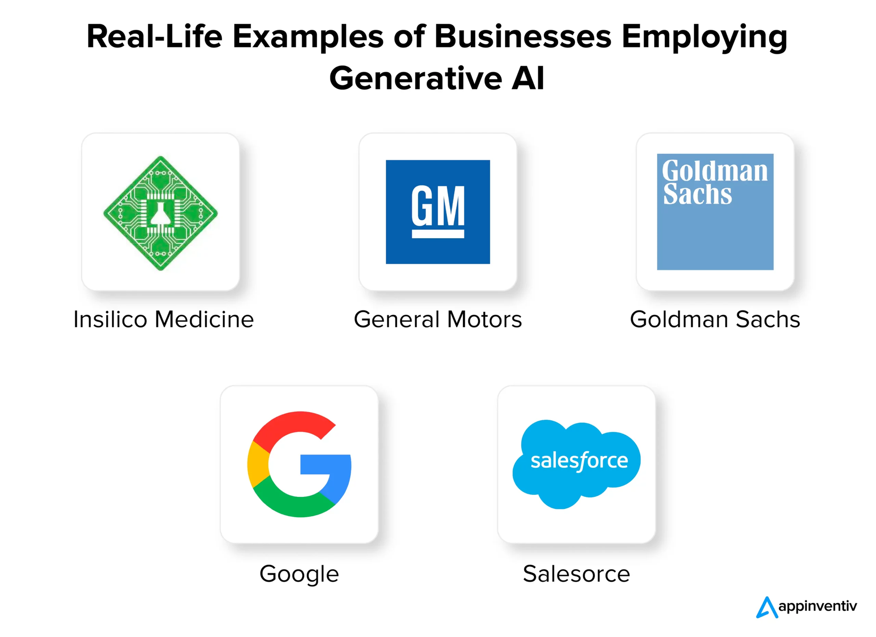

Slide 5


Slide 6

Title: Definition of Generative IA
GENERATIVE AI, ALSO KNOWN AS GENERATIVE INTELLIGENCE, IS A SUBSET OF ARTIFICIAL INTELLIGENCE (AI) FOCUSED ON GENERATING NEW AND ORIGINAL DATA OR CONTENT.
It leverages advanced deep learning architectures like generative adversarial networks (GANs), autoregressive models, and transformers.
Generative AI models are trained on existing data to learn patterns and then generate new data instances such as images, text, audio, or video that resemble the patterns observed in the training data.
Unlike traditional AI models that focus on classification or prediction tasks, generative AI is capable of creating diverse and realistic outputs.
It finds applications in various domains including image and video synthesis, natural language generation, music composition, and creative design.

Slide 7
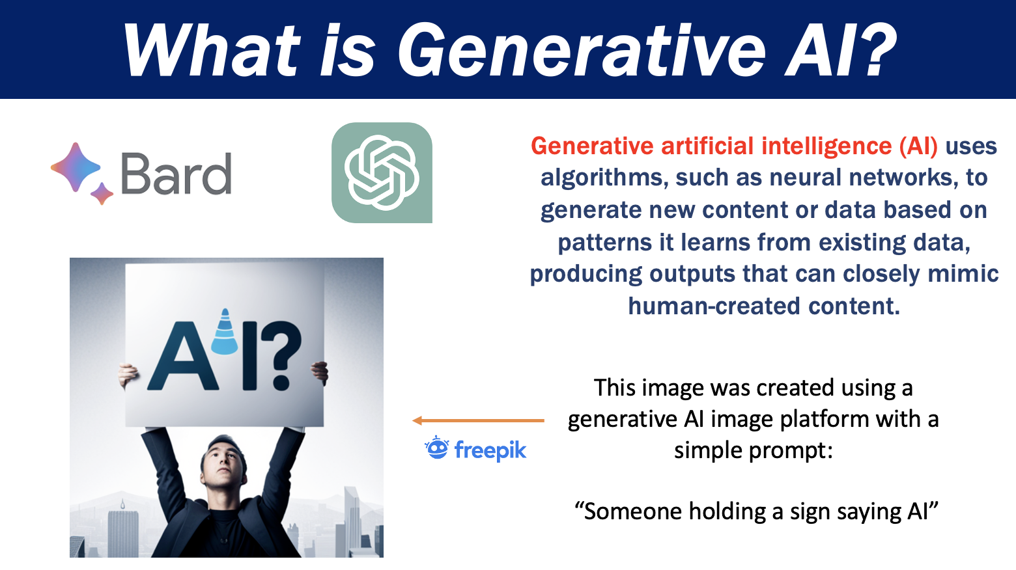

Slide 8
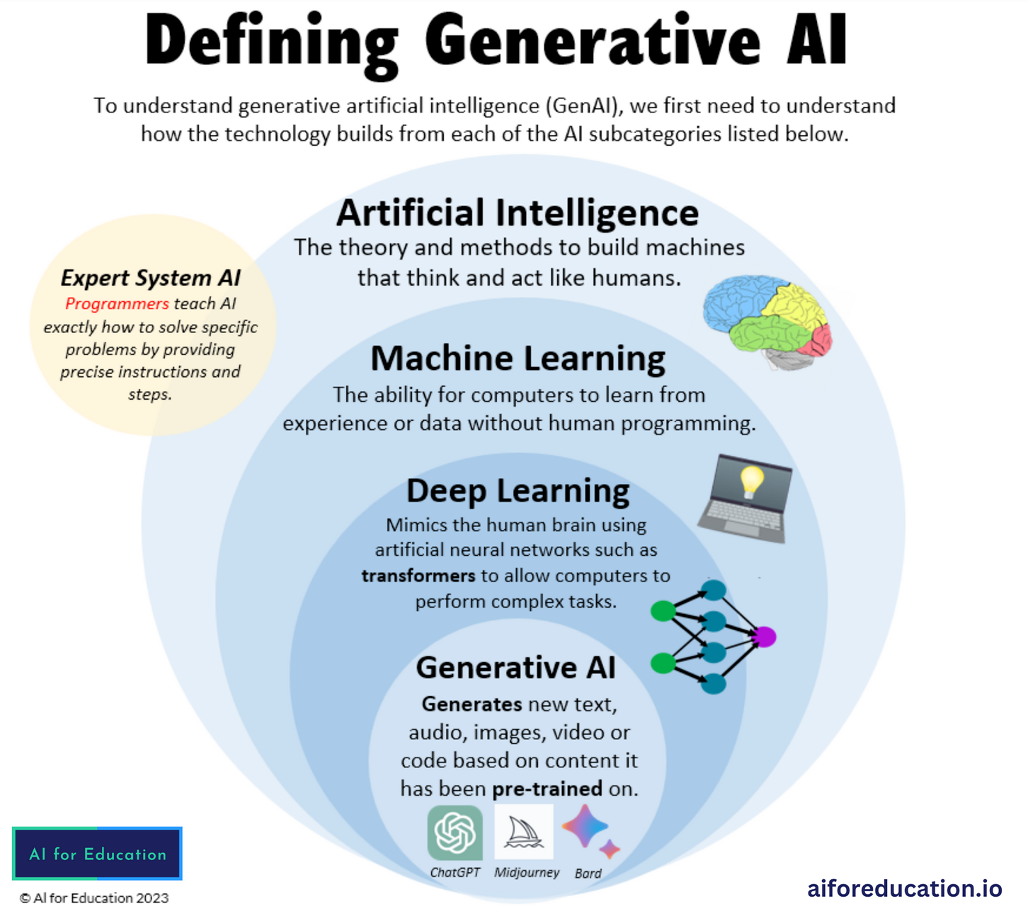

Slide 9


Slide 10
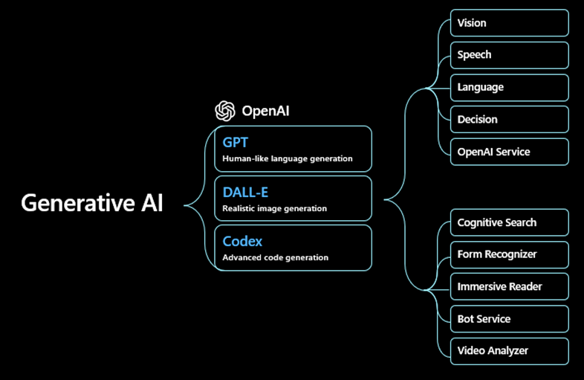

Slide 11
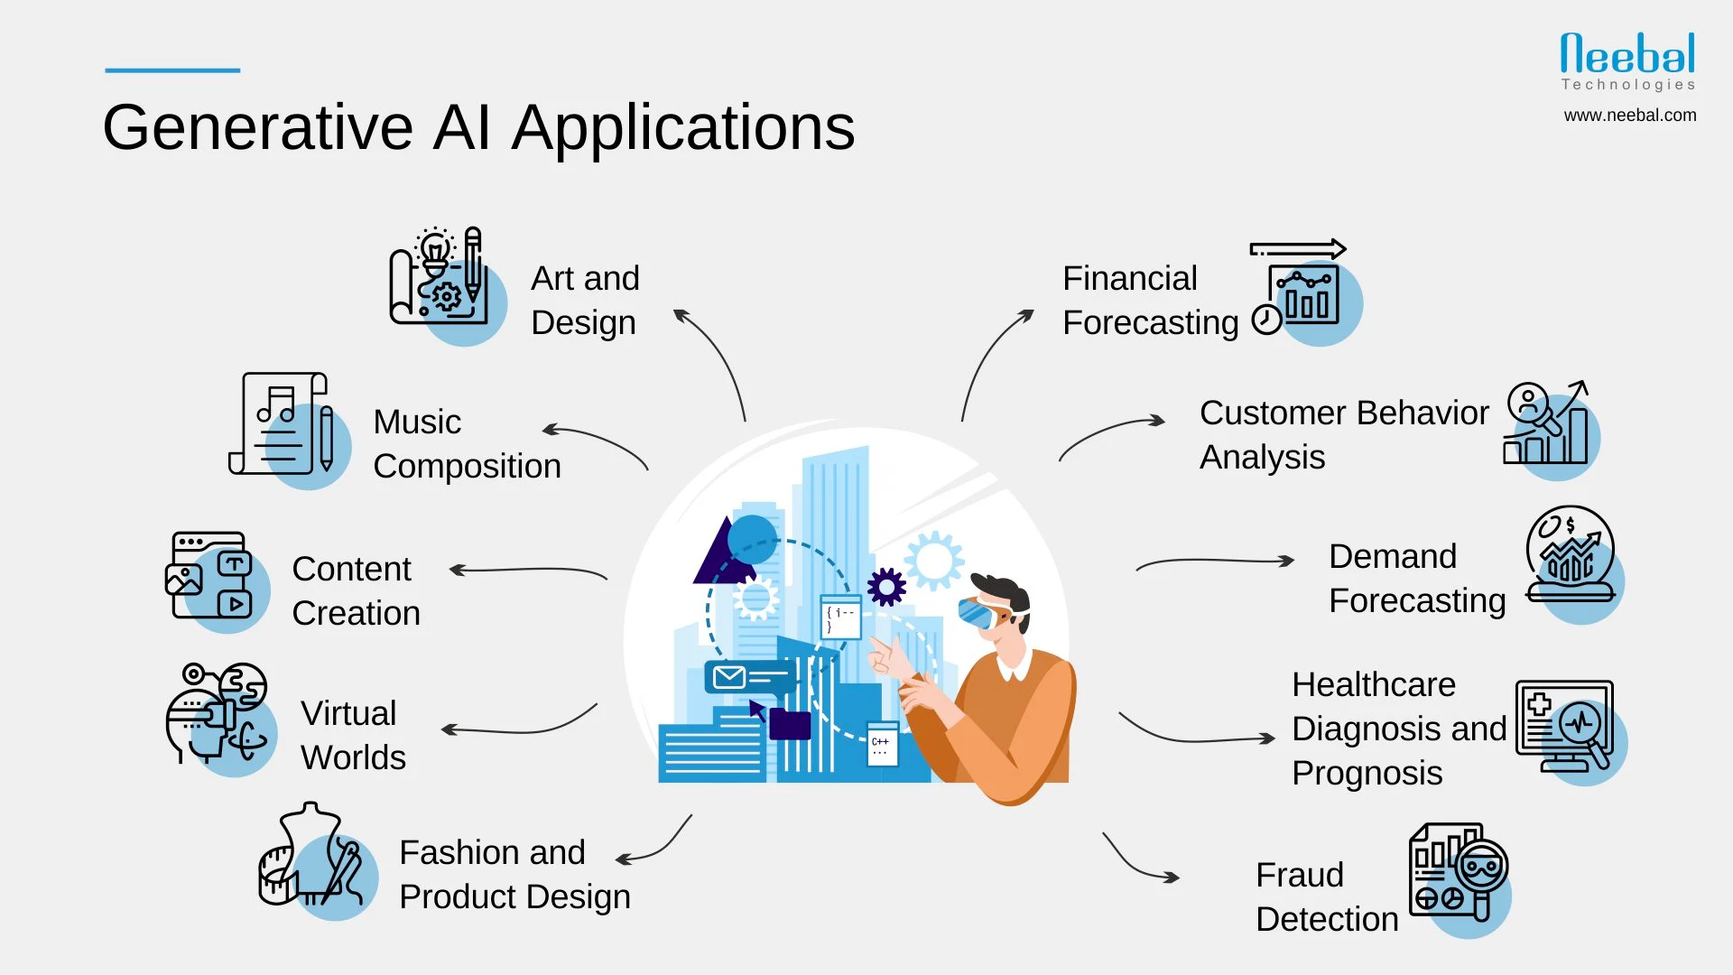

Slide 12
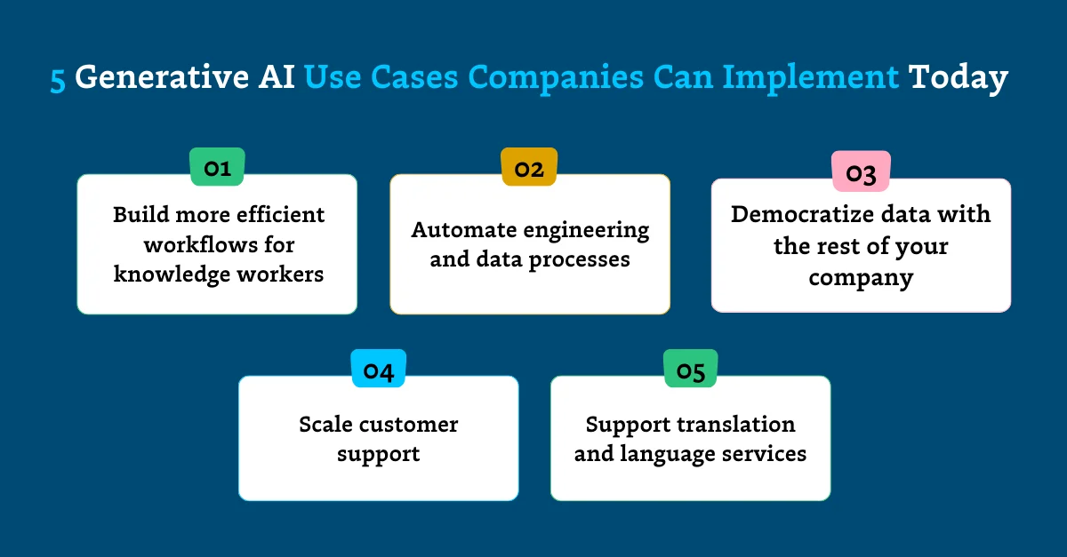

Slide 13

Introduction
Exploring the Impact of Advanced AI in Language Processing
1
Definition of Large Language Models (LLMs)
2
Overview of their significance in AI development
3
Importance of language comprehension in modern technology

Slide 14
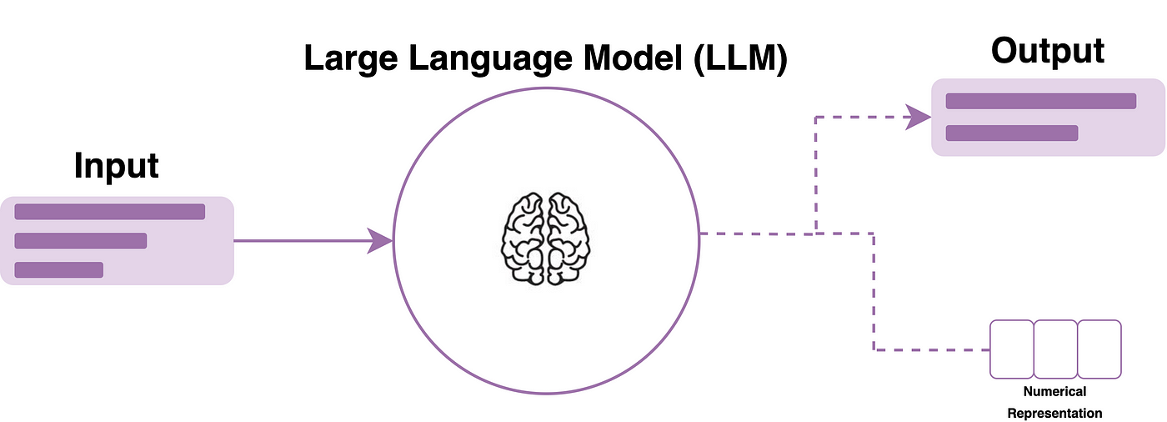

Slide 15
Title: Definition of Large Language Models (LLMs)
LARGE LANGUAGE MODELS (LLMS) REPRESENT A BREAKTHROUGH IN ARTIFICIAL INTELLIGENCE, ENCOMPASSING POWERFUL NEURAL NETWORKS TRAINED ON EXTENSIVE DATASETS. THESE MODELS, SUCH AS GPT (GENERATIVE PRE-TRAINED TRANSFORMER), ARE CAPABLE OF UNDERSTANDING, PROCESSING, AND GENERATING HUMAN-LIKE TEXT. THEY UTILIZE DEEP LEARNING TECHNIQUES AND MASSIVE AMOUNTS OF TEXT DATA TO COMPREHEND CONTEXT, STRUCTURE, AND LINGUISTIC PATTERNS.

Slide 16
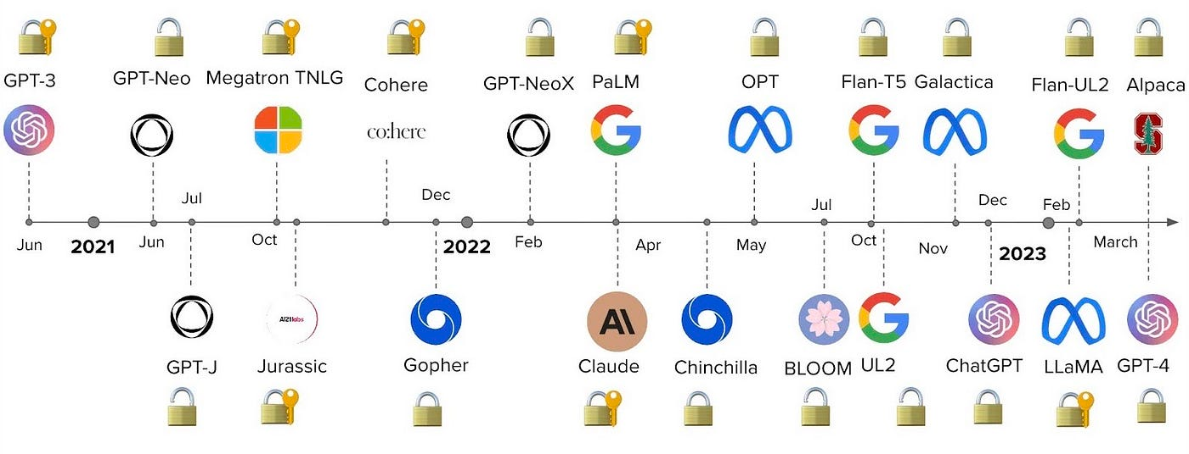

Slide 17
Title: Overview of their Significance in AI Development
THE EMERGENCE OF LLMS SIGNIFIES A MONUMENTAL ADVANCEMENT IN AI DEVELOPMENT. THESE MODELS HAVE SHIFTED THE LANDSCAPE OF NATURAL LANGUAGE PROCESSING, ENABLING MACHINES TO COMPREHEND AND GENERATE LANGUAGE WITH IMPRESSIVE ACCURACY. THEY'VE REVOLUTIONIZED VARIOUS LANGUAGE-RELATED TASKS, INCLUDING TEXT GENERATION, TRANSLATION, SUMMARIZATION, AND SENTIMENT ANALYSIS. THEIR SIGNIFICANCE LIES IN THEIR ABILITY TO UNDERSTAND CONTEXT, NUANCES, AND COMPLEXITIES OF HUMAN LANGUAGE, MARKING A CRUCIAL MILESTONE IN AI EVOLUTION.

Slide 18
Title: Importance of Language Comprehension in Modern Technology
LANGUAGE COMPREHENSION HOLDS IMMENSE IMPORTANCE IN MODERN TECHNOLOGY. LLMS PLAY A PIVOTAL ROLE IN BRIDGING THE GAP BETWEEN HUMAN COMMUNICATION AND TECHNOLOGICAL INTERACTION. THEIR PROFICIENCY IN COMPREHENDING LANGUAGE NUANCES FACILITATES MORE INTUITIVE AND EFFECTIVE HUMAN-COMPUTER INTERACTIONS. THIS CAPABILITY ENHANCES USER EXPERIENCES ACROSS APPLICATIONS, FROM CHATBOTS AND VIRTUAL ASSISTANTS TO CONTENT CURATION AND INFORMATION RETRIEVAL SYSTEMS. LLMS SIGNIFICANTLY CONTRIBUTE TO MAKING TECHNOLOGY MORE ACCESSIBLE, EFFICIENT, AND USER-FRIENDLY IN OUR DIGITAL LANDSCAPE.

Slide 19

Evolution of LLMs
Exploring the Impact of Advanced AI in Language Processing
Introduction of transformer architectures
development stages
1
3
5
2
4
Historical background
ML vs LLM
Key advancements leading to modern LLMs

Slide 20
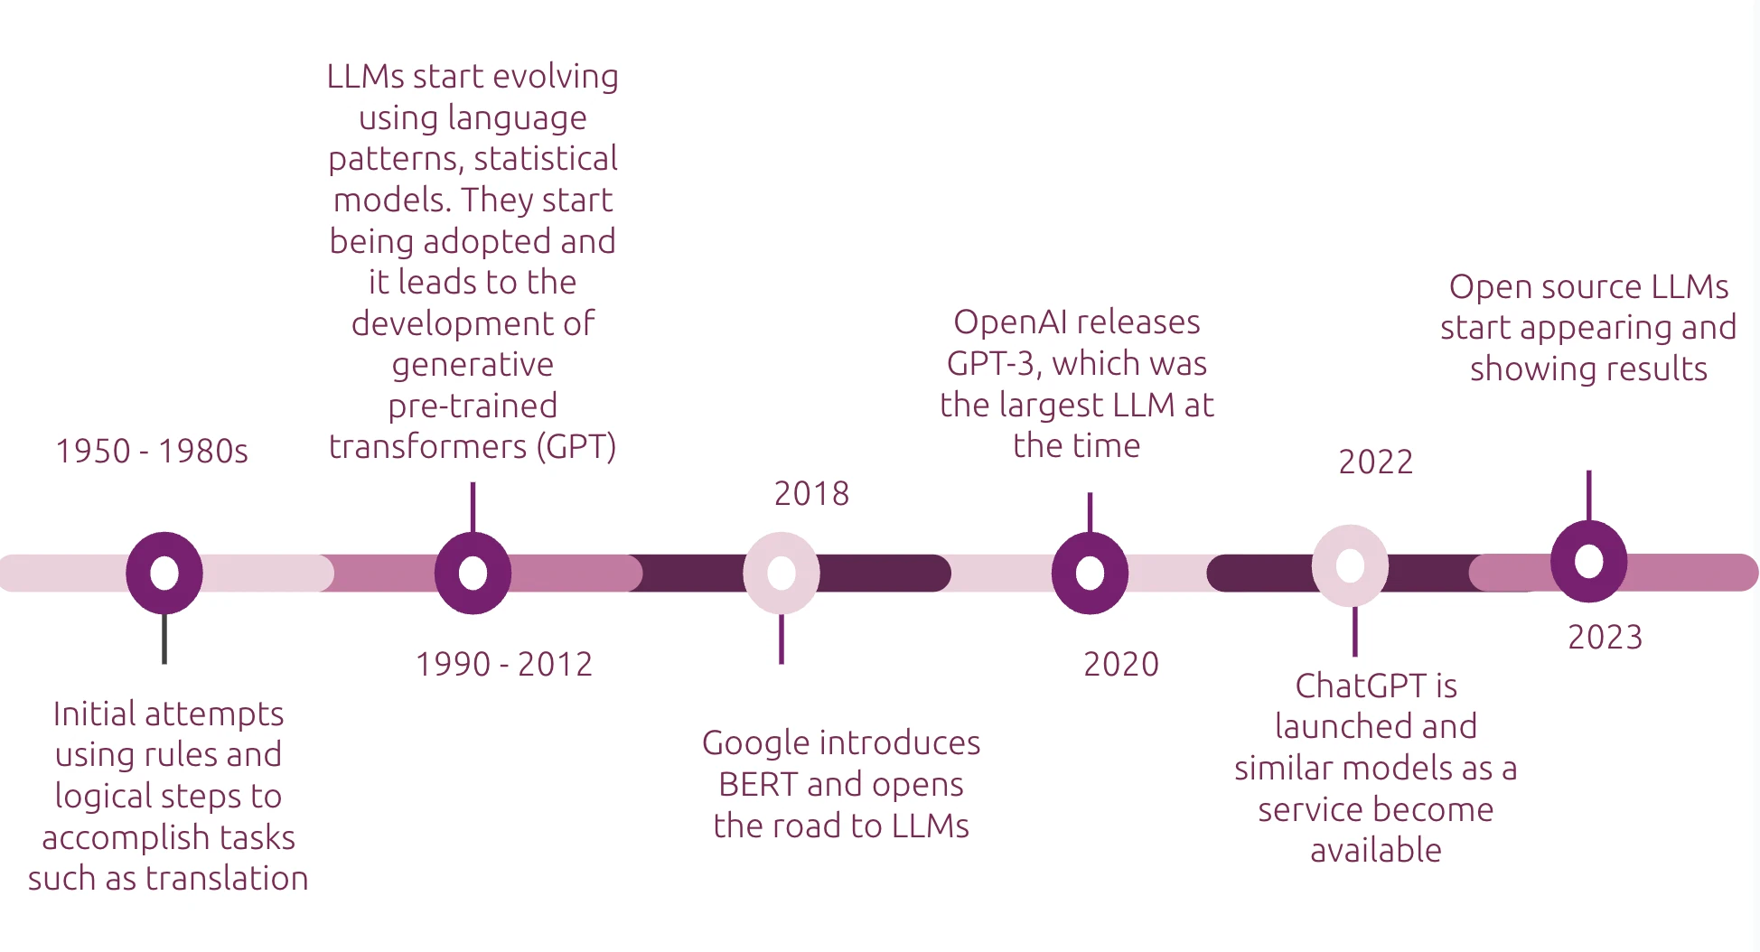

Slide 21
Title: Historical Background and Development Stages
THE EVOLUTION OF LARGE LANGUAGE MODELS (LLMS) TRACES BACK TO EARLY DEVELOPMENTS IN ARTIFICIAL INTELLIGENCE AND NATURAL LANGUAGE PROCESSING. INITIAL STAGES INVOLVED FOUNDATIONAL RESEARCH IN MACHINE LEARNING AND LANGUAGE MODELING. OVER TIME, ADVANCEMENTS IN NEURAL NETWORK ARCHITECTURES PAVED THE WAY FOR MORE SOPHISTICATED MODELS CAPABLE OF HANDLING VAST AMOUNTS OF TEXTUAL DATA.

Slide 22
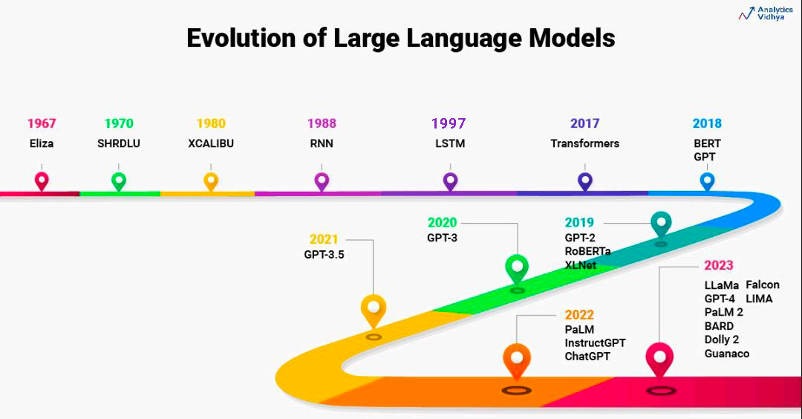

Slide 23
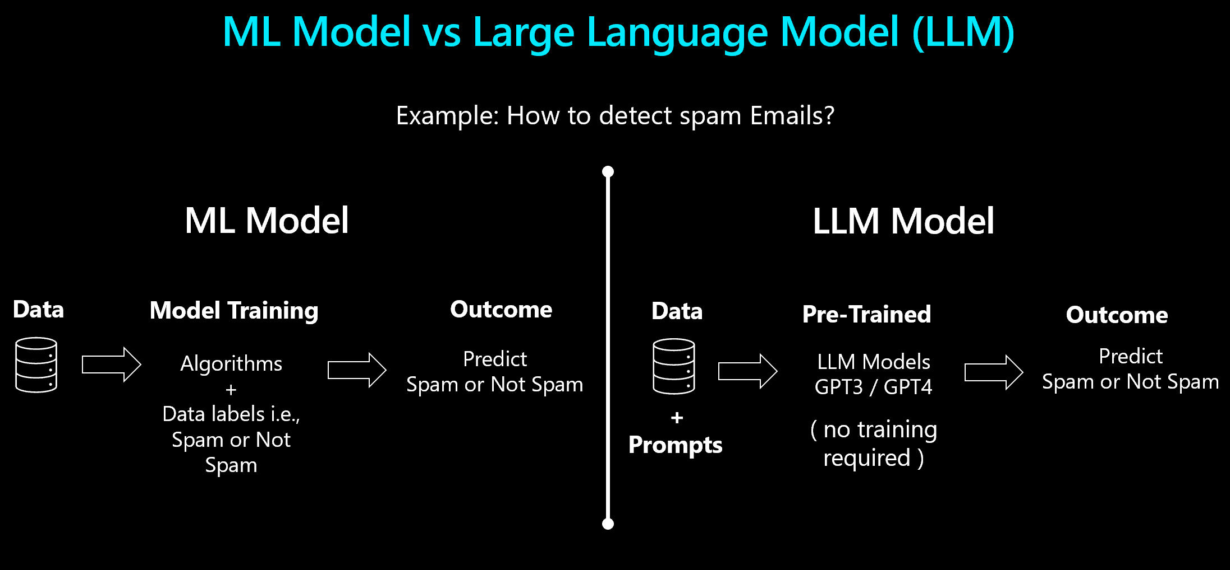

Slide 24
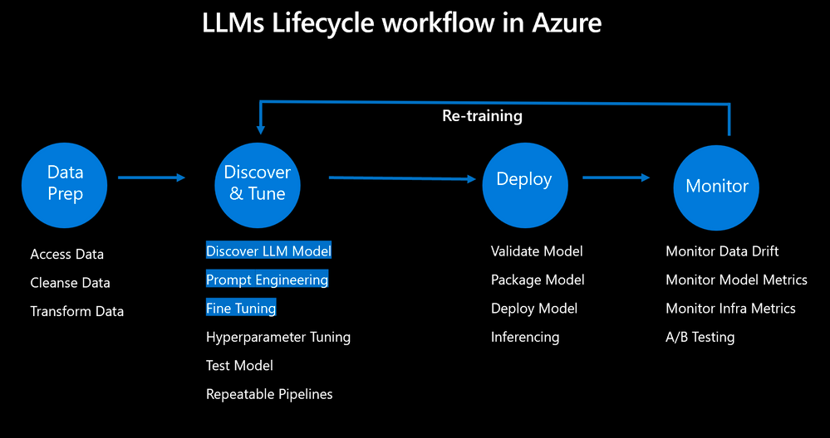

Slide 25
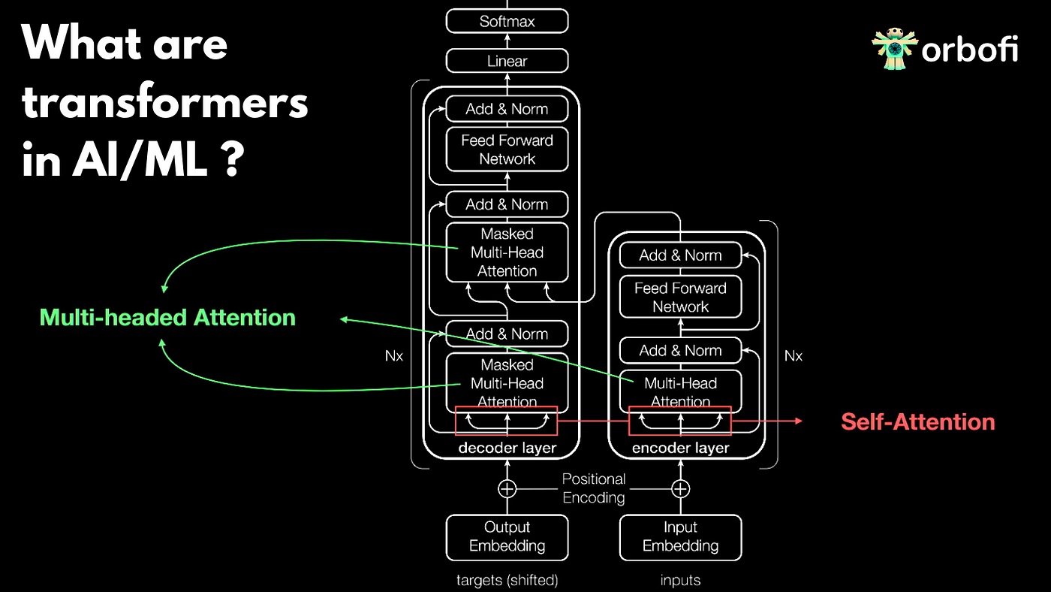

Slide 26
Title: Introduction of Transformer Architectures
A SIGNIFICANT TURNING POINT IN THE EVOLUTION OF LLMS WAS THE INTRODUCTION OF TRANSFORMER ARCHITECTURES. THIS INNOVATIVE FRAMEWORK, NOTABLY HIGHLIGHTED IN THE TRANSFORMER MODEL, REVOLUTIONIZED LANGUAGE PROCESSING BY ENABLING MORE EFFICIENT LEARNING OF CONTEXTUAL RELATIONSHIPS WITHIN TEXT. TRANSFORMERS, WITH THEIR ATTENTION MECHANISMS, FACILITATED PARALLEL COMPUTATION AND IMPROVED THE UNDERSTANDING OF LONG-RANGE DEPENDENCIES, LAYING THE GROUNDWORK FOR MORE COMPLEX AND EFFECTIVE LANGUAGE MODELS

Slide 27
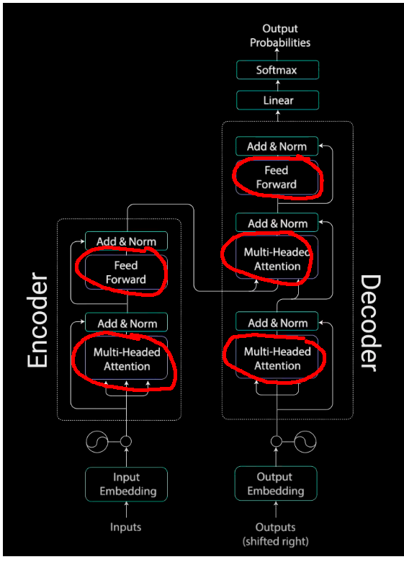

Slide 28
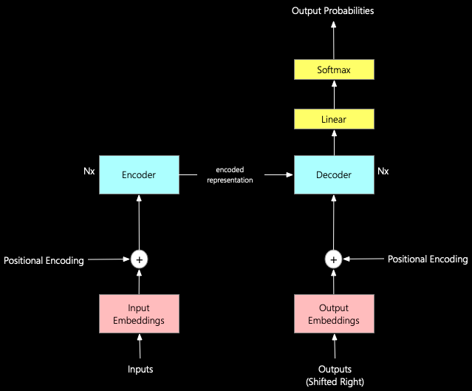

Slide 29
Title: Key Advancements Leading to Modern LLMs
THE JOURNEY TOWARD MODERN LLMS HAS BEEN CHARACTERIZED BY PIVOTAL ADVANCEMENTS. THE REFINEMENT OF TRAINING TECHNIQUES, THE UTILIZATION OF LARGER AND MORE DIVERSE DATASETS, AND THE OPTIMIZATION OF MODEL ARCHITECTURES HAVE BEEN INSTRUMENTAL. BREAKTHROUGHS IN UNSUPERVISED PRE-TRAINING AND FINE-TUNING METHODOLOGIES HAVE SIGNIFICANTLY BOOSTED THE PERFORMANCE AND CAPABILITIES OF LLMS, ALLOWING FOR MORE ACCURATE LANGUAGE UNDERSTANDING, GENERATION, AND TASK-SPECIFIC ADAPTATIONS. THESE ADVANCEMENTS HAVE CULMINATED IN THE CREATION OF STATE-OF-THE-ART MODELS LIKE GPT-3, SHOWCASING UNPRECEDENTED LANGUAGE PROCESSING CAPABILITIES.

Slide 30
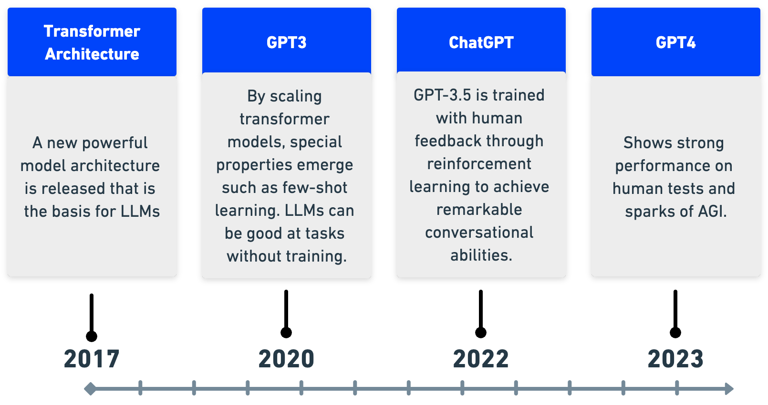

Slide 31
Title: Explanation of the Functioning of LLMs
LARGE LANGUAGE MODELS (LLMS) OPERATE THROUGH COMPLEX NEURAL NETWORK ARCHITECTURES DESIGNED TO UNDERSTAND AND GENERATE HUMAN-LIKE TEXT. THESE MODELS LEVERAGE TRANSFORMER-BASED ARCHITECTURES, UTILIZING LAYERS OF NEURONS THAT PROCESS INPUT TEXT IN SEQUENTIAL STAGES. THROUGH A SERIES OF COMPUTATIONS AND TRANSFORMATIONS, LLMS INTERPRET THE CONTEXT, SEMANTICS, AND SYNTAX OF LANGUAGE, ENABLING THEM TO GENERATE COHERENT AND CONTEXTUALLY RELEVANT RESPONSES.

Slide 32
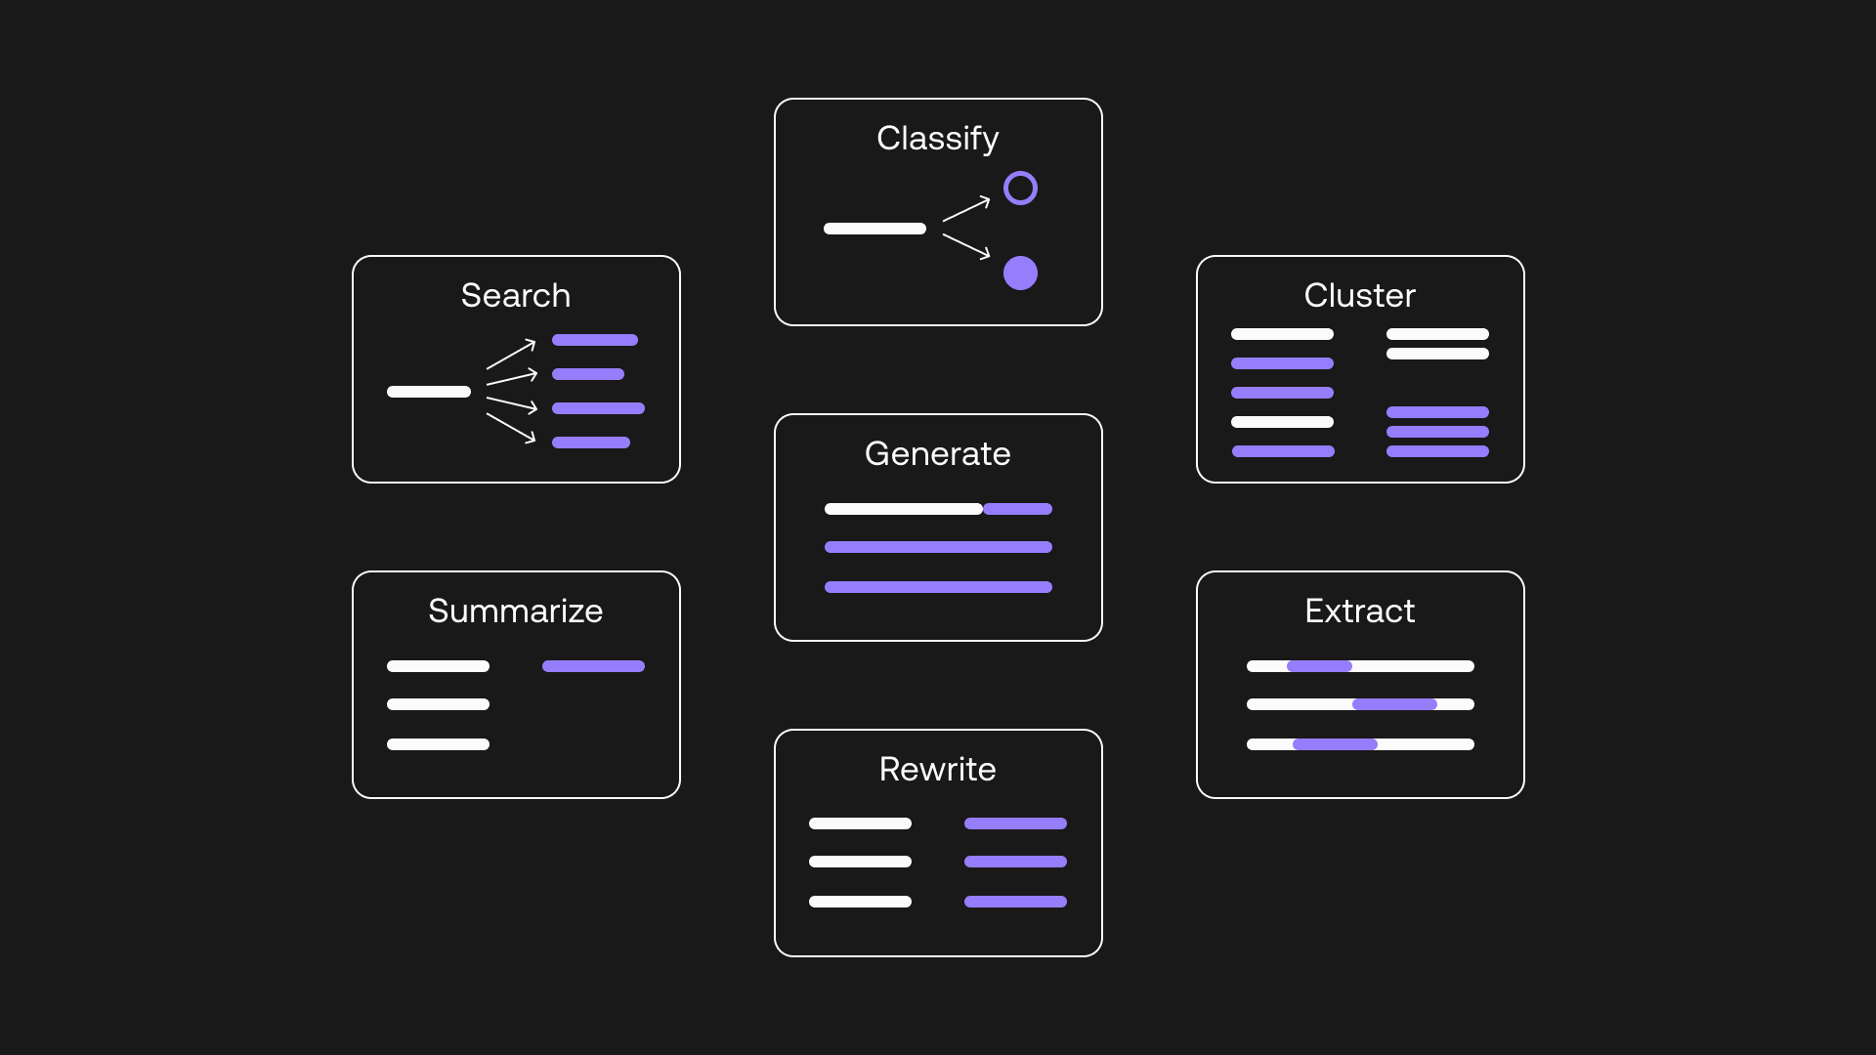

Slide 33
Title: Insight into Transformer Models and Their Mechanisms
AT THE CORE OF LLMS, TRANSFORMER MODELS EMPLOY ATTENTION MECHANISMS TO PROCESS INPUT DATA. THESE MECHANISMS ENABLE THE MODEL TO WEIGH AND PRIORITIZE DIFFERENT PARTS OF THE INPUT TEXT, FOCUSING ON CRUCIAL ELEMENTS WHILE CONSIDERING THE ENTIRE CONTEXT. BY ATTENDING TO RELEVANT SEGMENTS AND RELATIONSHIPS WITHIN THE TEXT, TRANSFORMERS CAN CAPTURE DEPENDENCIES, UNDERSTAND CONTEXT, AND GENERATE RESPONSES THAT ALIGN WITH THE INPUT CONTEXT, LEADING TO MORE COHERENT AND CONTEXTUALLY RELEVANT OUTPUTS.

Slide 34
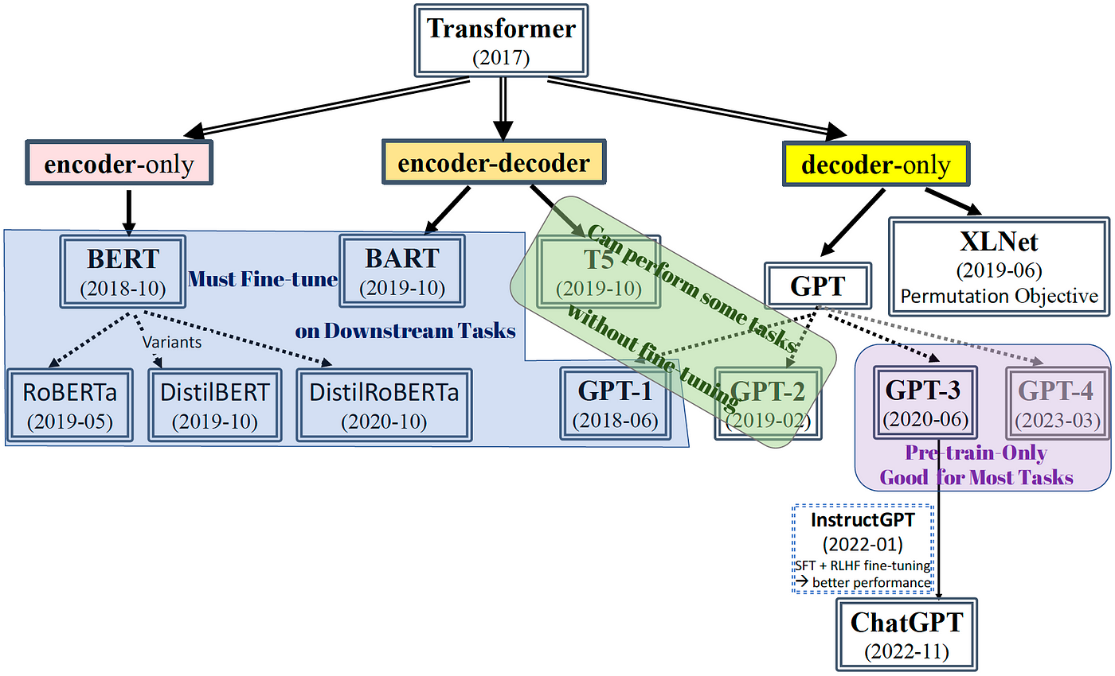

Slide 35
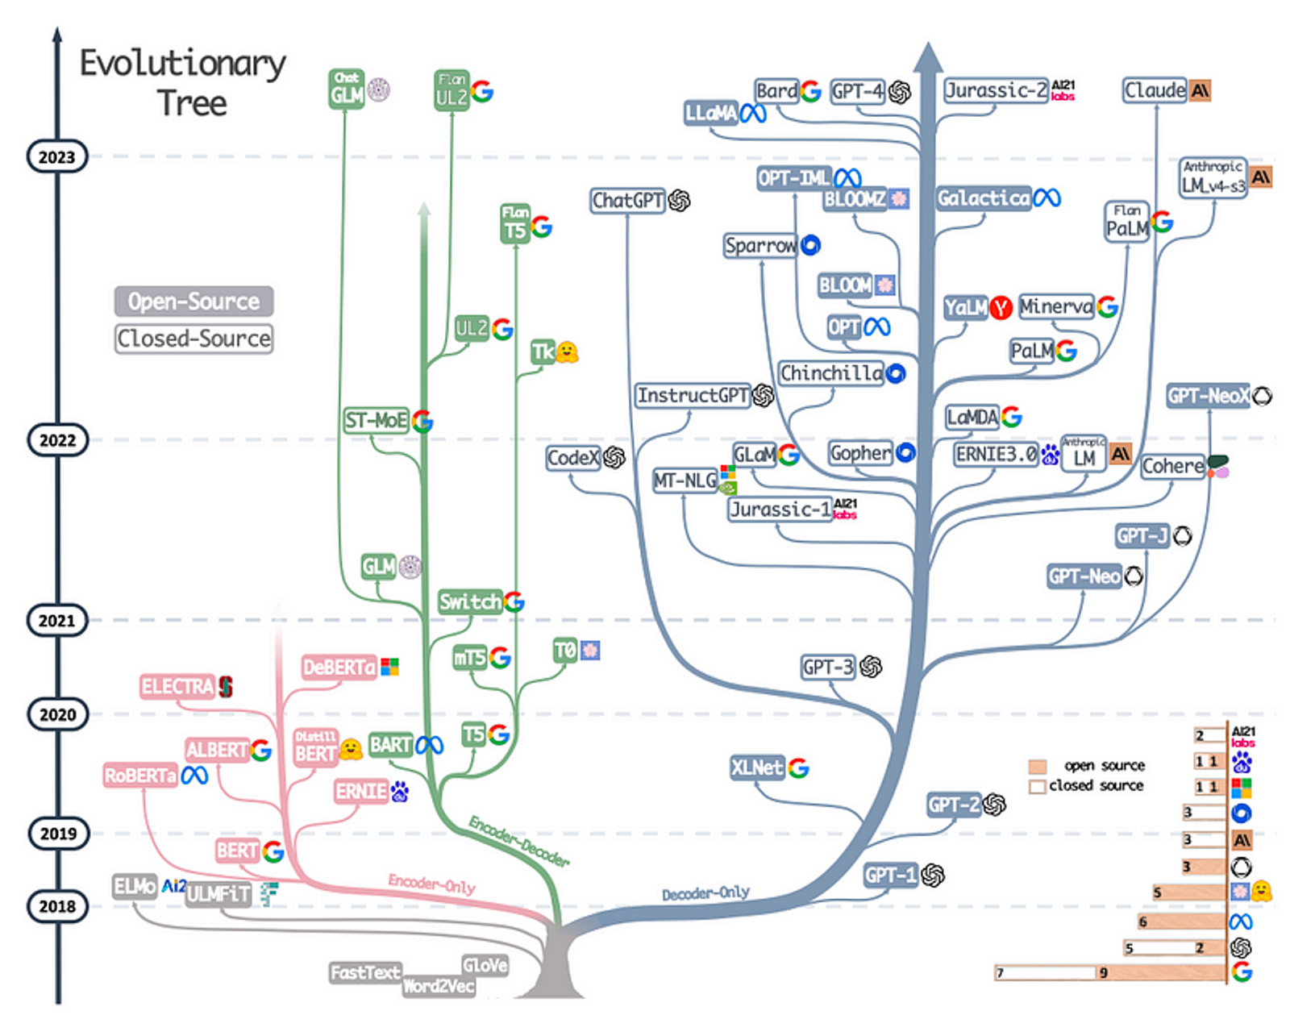

Slide 36
Title: Role of Training Data in Model Comprehension
THE TRAINING DATA FORMS THE BEDROCK OF LLM COMPREHENSION. THESE MODELS ARE TRAINED ON VAST AND DIVERSE DATASETS COMPRISING TEXT FROM VARIOUS SOURCES, INCLUDING BOOKS, ARTICLES, WEBSITES, AND MORE. THE QUALITY, QUANTITY, AND DIVERSITY OF THIS TRAINING DATA SIGNIFICANTLY INFLUENCE THE MODEL'S LANGUAGE COMPREHENSION CAPABILITIES. THROUGH EXPOSURE TO DIVERSE LINGUISTIC PATTERNS AND CONTEXTS, LLMS LEARN TO RECOGNIZE AND REPLICATE LANGUAGE STRUCTURES, IMPROVING THEIR ABILITY TO UNDERSTAND AND GENERATE HUMAN-LIKE TEXT.

Slide 37





Applications of LLMs
Exploring the Impact of Advanced AI in Language Processing
5
Large Language Models (LLMs) have found widespread applications across numerous fields due to their versatile language processing capabilities.
2
1
LLMs excel in various language-related tasks, including but not limited to text generation, translation, summarization, and sentiment analysis
These models are utilized in industries such as healthcare, finance, education, and entertainment, among others.
3
4
Impact on Customer Service, Content Creation, and Data Analysis
These capabilities have transformed how information is processed, shared, and understood across different languages and contexts.

Slide 38
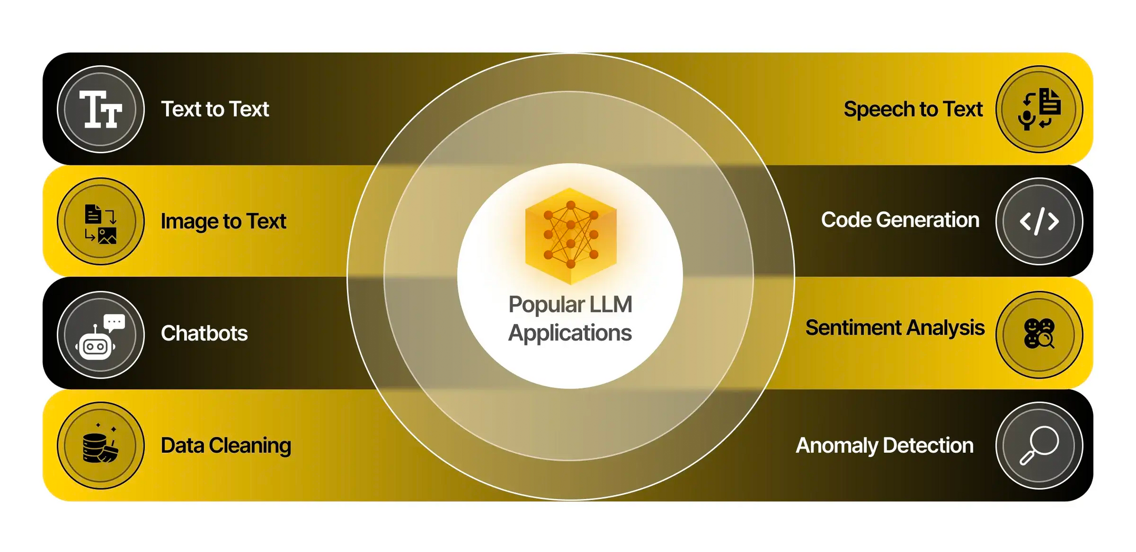

Slide 39
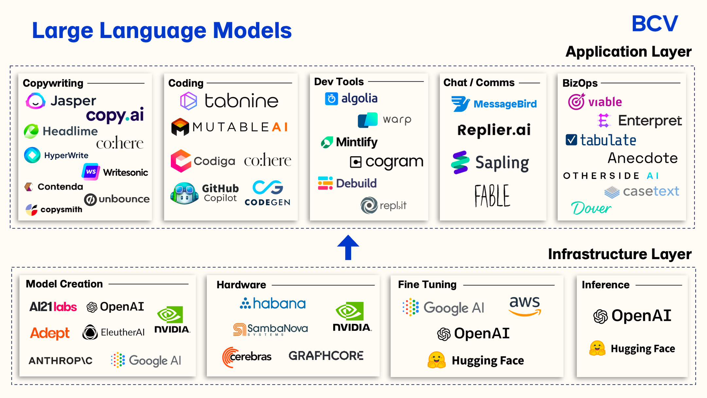

Slide 40
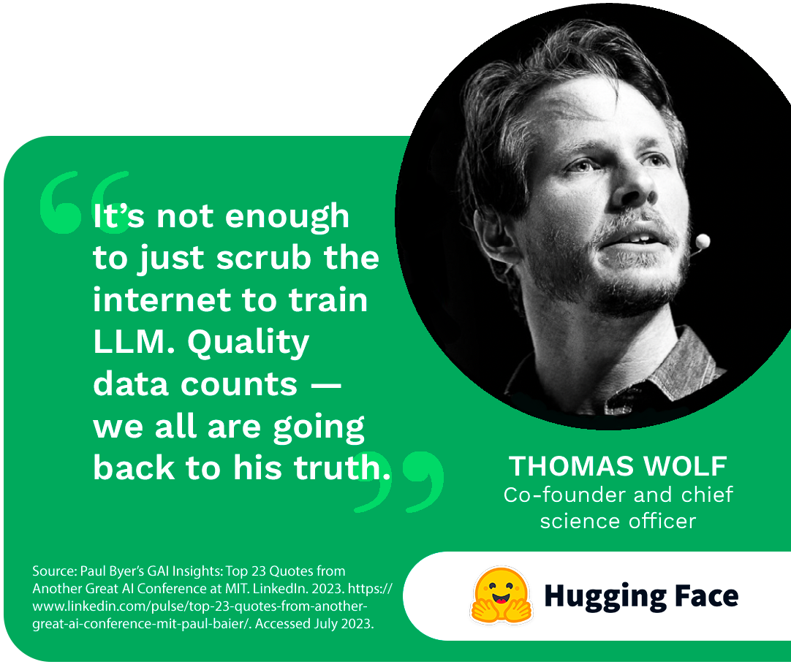

Slide 41
Title: Ethical Challenges Associated with LLMs
THE INTEGRATION OF LARGE LANGUAGE MODELS (LLMS) INTO VARIOUS APPLICATIONS RAISES SIGNIFICANT ETHICAL CONCERNS. THESE MODELS, WHILE POWERFUL IN LANGUAGE PROCESSING, ARE SUSCEPTIBLE TO INHERENT BIASES PRESENT IN THE TRAINING DATA. BIASES, BOTH SOCIETAL AND LINGUISTIC, CAN PERPETUATE AND AMPLIFY EXISTING INEQUALITIES, LEADING TO BIASED OUTPUTS OR DISCRIMINATORY LANGUAGE PATTERNS IN GENERATED TEXT. ADDITIONALLY, CONCERNS ARISE REGARDING THE ETHICAL RESPONSIBILITY OF THOSE DEPLOYING THESE MODELS IN VARIOUS APPLICATIONS.

Slide 42
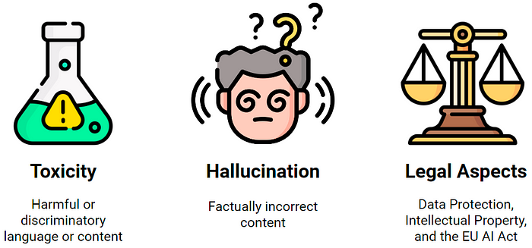

Slide 43
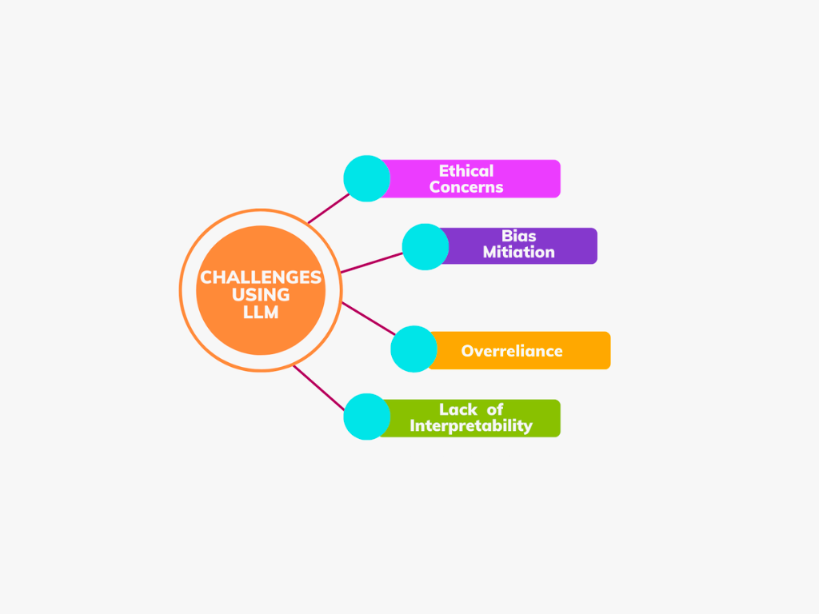

Slide 44
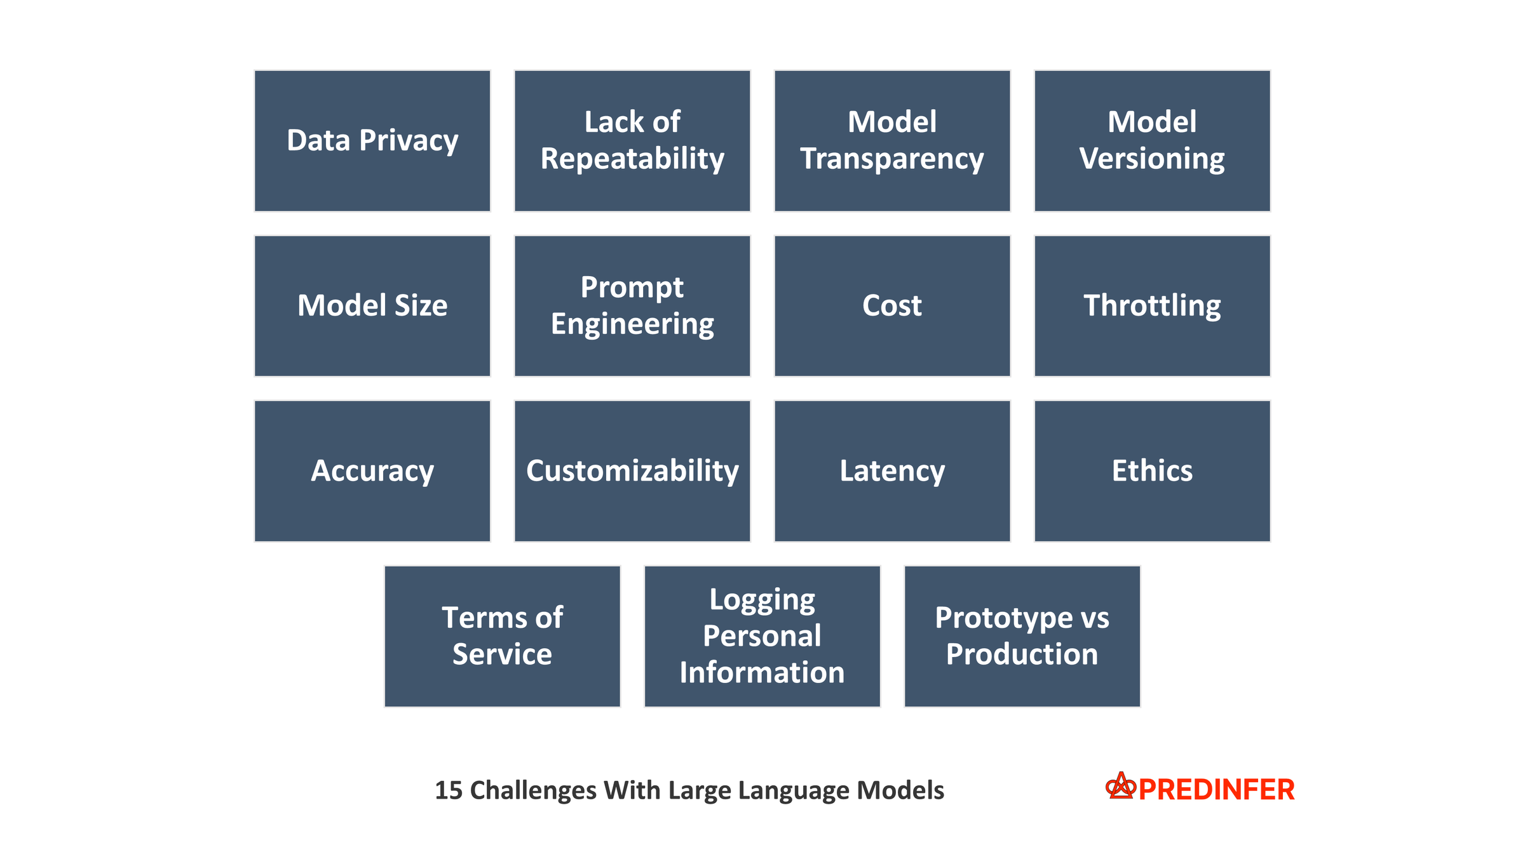

Slide 45
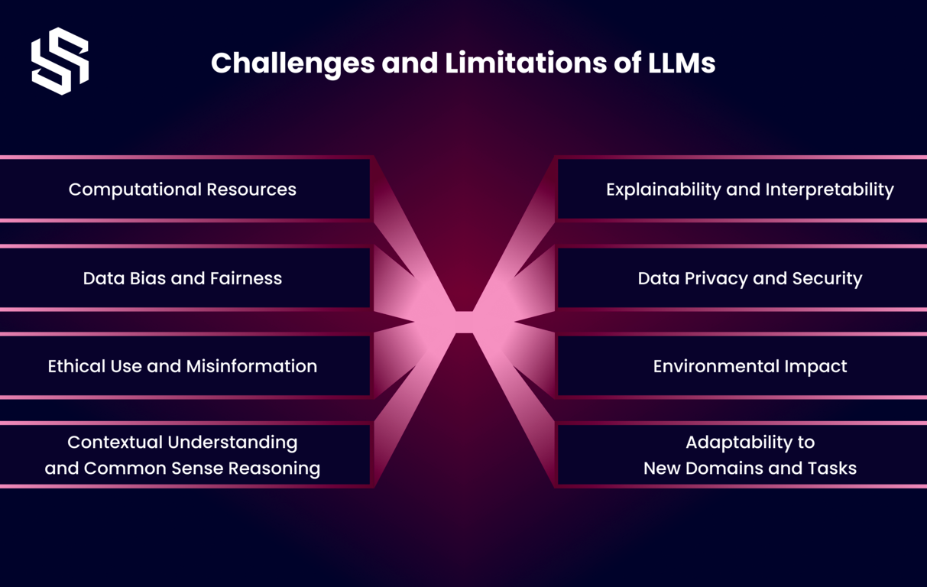

Slide 46

For any further inquiries or collaborations, please feel free to reach out:
MANAI MED MORTADHA :
CEO @Man.Ai |Technical Reviewer @Packt | AI Engineer | XAI Engineer @Netflix| 2024 AI Apprentice @Google | AI Instructor | Google DSC Mentor | Intel Certified Edge AI Developer | XAI Researcher
Linkedin: https://www.linkedin.com/in/mannai-mortadha/
GIithub : https://github.com/MortadhaMannai
Leetcode : https://leetcode.com/mannaimortadha898/
Sessionize: https://sessionize.com/Mortadha_Mannai/
Email : mannaimortadha898@gmail.com
Paper Link: https://zenodo.org/records/8274725

Slide 47


